Slide 1
Data analytics portfolio
Heather Visentin

Slide 2
Projects
01
Game Co
02
Influenza Preparation
03
Rockbuster
Analyzing global video
game sales.
Planning for the upcoming flu season.
Creating a strategy for the launch
of a new online video service.
04
Instacart
05
Global Bank
06
World Happiness Report
Analyzing sales data to uncover sales patterns.
Provide analytical support to its anti-money laundering compliance department.
Sourced data and performed exploratory analysis.

Slide 3
Game co
01

Slide 4
Game co
Objective
Tools Used
Skills Used
To perform a descriptive analysis of a video game data set to assist GameCo in predictive how their new games will perform in the market.
Microsoft Excel
Microsoft Powerpoint
Grouping data
Summarizing data
Descriptive analysis
Visualizing results
Presenting results

Slide 5
Game co
Regional Sales Relative to Global Sale
2006-2016
It was important to look at proportional sales to see which markets had the largest percentage of sales. This helps us with knowing which market to focus on. We can see here that the European market has the highest percentage of sales in the most recent years.

Slide 6
Game co
Total Sales by Genre
2006-2016
Looking into genres helps tell us which genres to focus on per region. Action, shooter and sports should be the main focus in both the European and North American markets, but the Japanese market should be focused on role-playing, action and misc.

Slide 7
Game co
Final Results
European Market as largest market
Genre differences
North American market decreasing in sales
Adjust marketing schedule to reflect this change in sales.
Japanese market also increasing, investigate how to better capture that market.
Adjust marketing to reflect that the NA and EU markets sell differently than the JP market.
More research into Misc. genre as it is top performing.
More research as to why the NA market is losing market share.
Advertising or marketing budget to help increase sales.

Slide 8
Influenza preparation
02

Slide 9
Influenza preparation
Objective
Tools Used
Skills Used
To help a medical staffing agency with planning where to send their temporary staff for the upcoming flu season.
Microsoft Excel
Microsoft Powerpoint
Tableau
Translating business requirements
Data cleaning
Data Integration
Data transformation
Statistical hypothesis testing
Visual analysis
Forecasting
Storytelling in Tableau
Presenting results to an audience

Slide 10
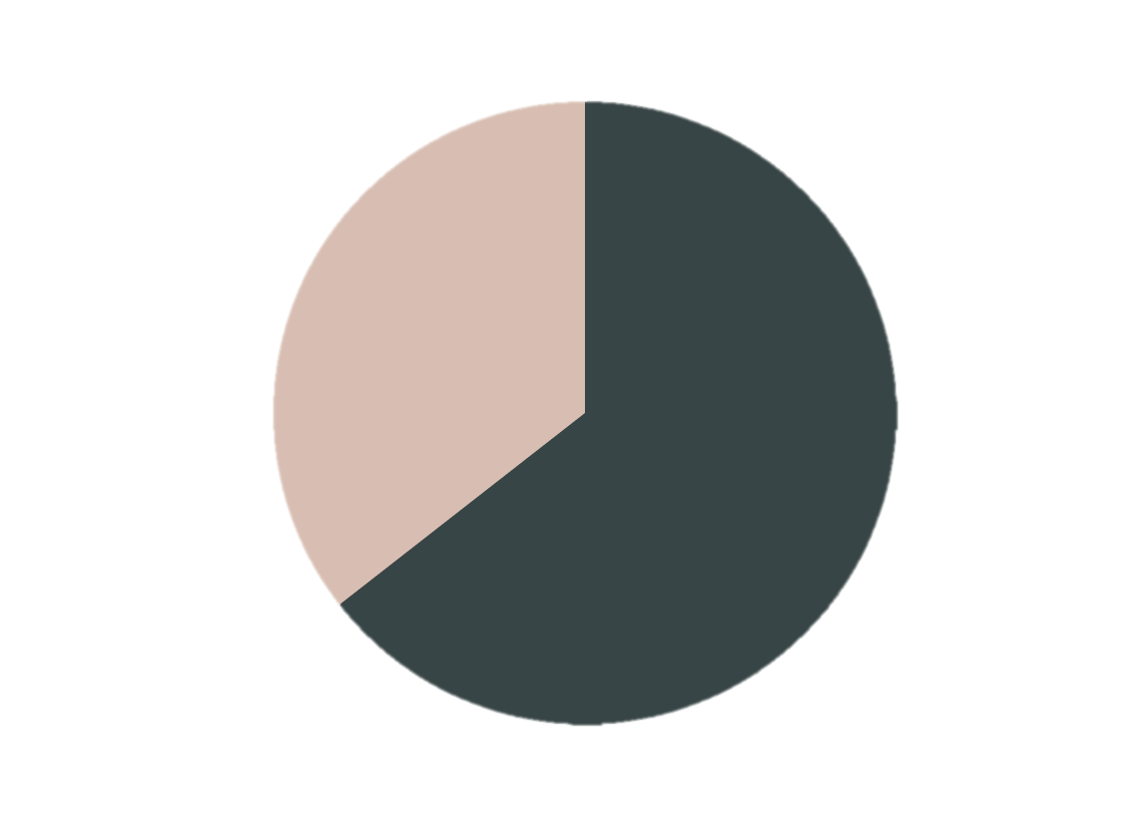
INFLUENZA PREPARATION
Influenza Related Deaths
Number of Deaths
Under 65
225, 297
Number of Deaths
Over 65
408, 395
Knowing who is most at risk allowed us to then look at where this group of people is located. Knowing that people over 65 were at a might higher risk of death meant that we should look at which states have the largest amount of people in this age group.

Slide 11
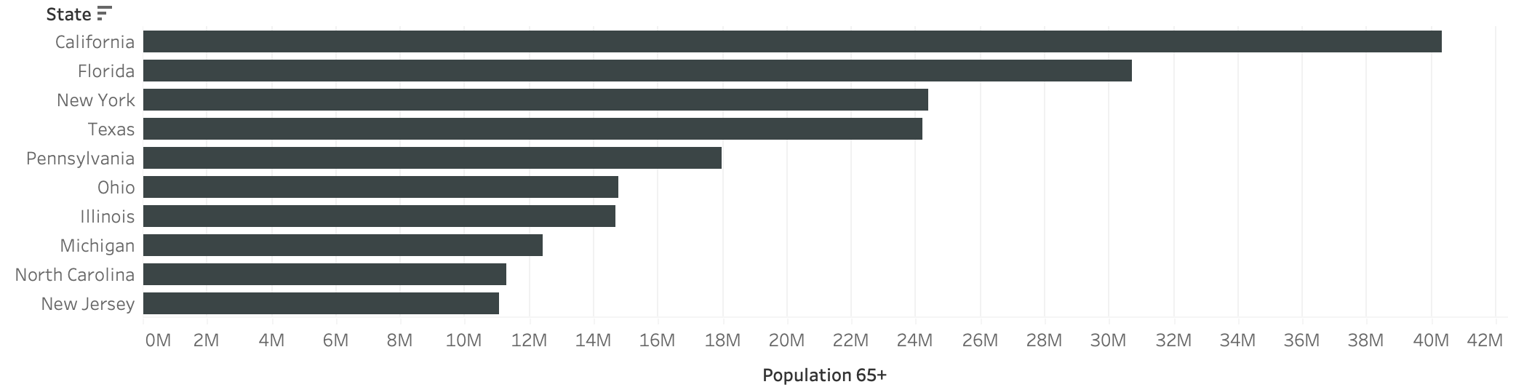
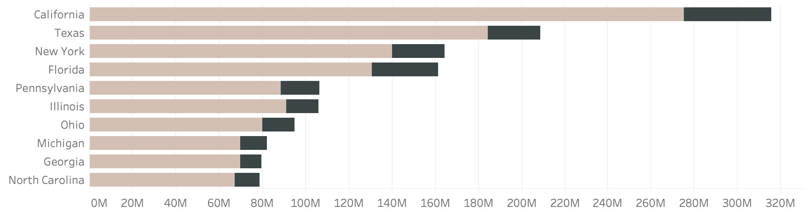
INFLUENZA PREPARATION
Population Over 65 by State
We already know that people 65+ are at a higher risk for influenza related deaths, so looking at where people in this age group are located helped us determine where sending staff would be most beneficial
Influenza Related Deaths by State
We also wanted to look at total deaths (pink being over 65 and black being under 65) by state to compare if population and deaths were related. While not in the exact same order, the top 5 states for population over 65 also have the most deaths.

Slide 12
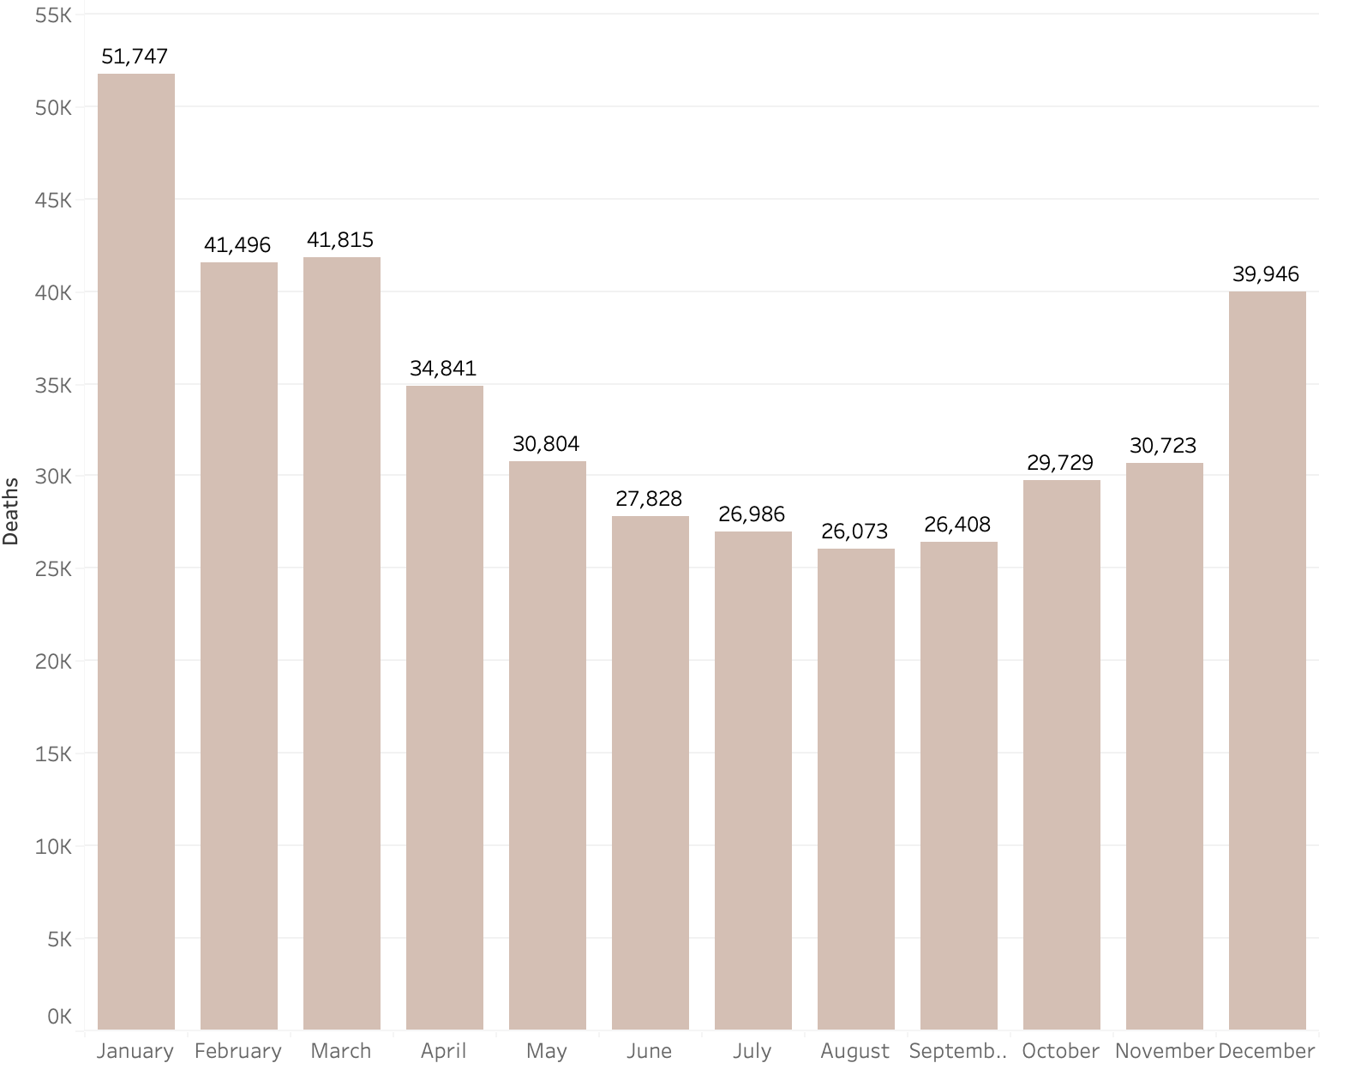
INFLUENZA PREPARATION
Influenza Related Deaths By Month
We also needed to determine when people were most at risk. This helped us to inform the medical staffing agency as to when they would need to send out staffing to the states most at risk.

Slide 13
Influenza preparation
Final Results
People over 65 at a greater risk of death
Target states with high population over 65
Certain months have significantly more deaths
States with larger populations of people 65+ should take top priority when sending out staff.
California, Florida, New York, Texas and Pennsylvania have the highest populations of people over 65.
These states need to be made a priority when sending staff.
December through March are the months with the highest influenza death rates.
More staffing should be sent during these months.
Tableau
Presentation

Slide 14
Rockbuster
03

Slide 15
Rockbuster
Objective
Tools Used
Skills Used
To help with the launch strategy for the new online video service.
Microsoft Excel
Microsoft Powerpoint
SQL
Tableau
DBVisualizer
Relational databases
Database querying
Filtering
Cleaning and summarizing
Joining tables
Subqueries
Common table expressions

Slide 16
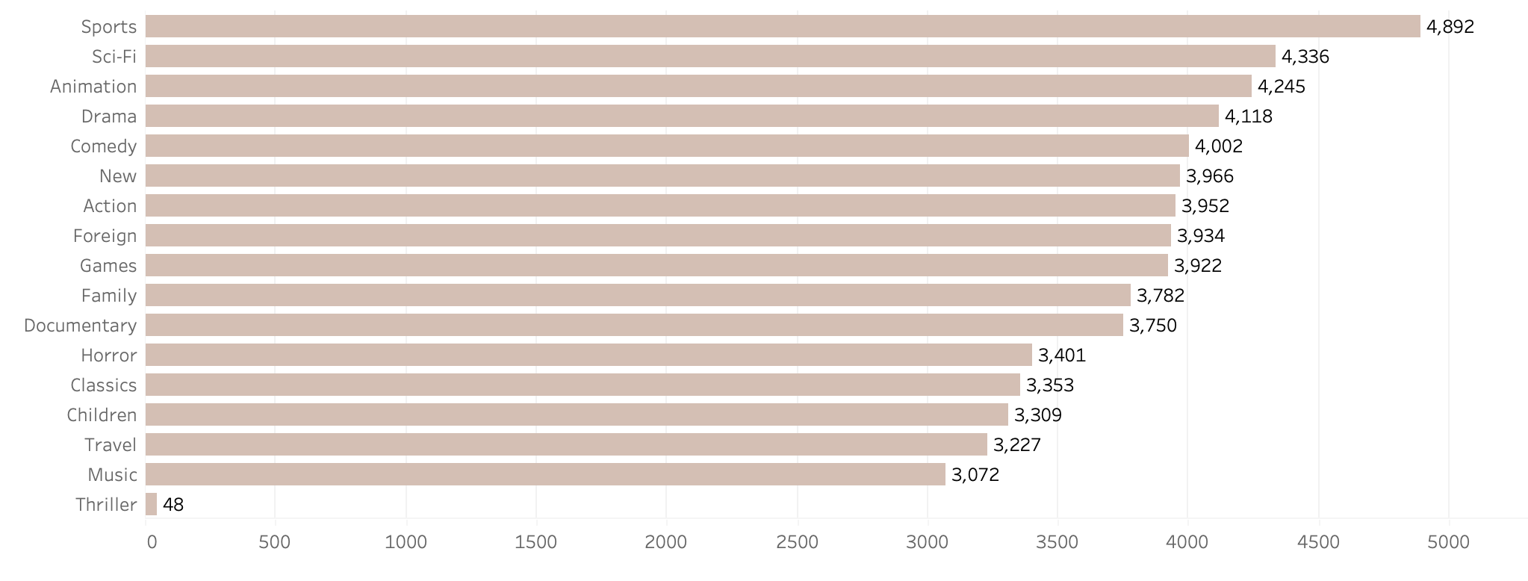
Rockbuster
Revenue by Genre
Taking a look at what genres are currently performing best will help give us insight into what we should have on the new platform to perform well. It is worth noting that we also made sure to compare the amount of movies in each category.

Slide 17
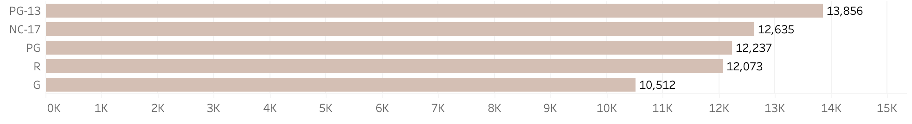
Rockbuster
Revenue by Rating
We wanted to see which rating performed the best. Similar to genres, this will help make informed decisions on which ratings to have on the new online video system. We also looked at how many of each rating we had to make a fair comparison.

Slide 18
Rockbuster
Top Regions for Sales
Finding out where we have the highest revenue currently will help with knowing where to target the advertising and marketing budgets. Also knowing where the least amount of revenue is coming from allows us to investigate into how to enter that market.

Slide 19
Rockbuster
Final Results
Some genres sell better than others
Revenue from ratings differs
Asia is the largest sales region
Focus on adding inventory to the top selling genres and less inventory to the others.
Thriller having only one title is an outlier, add more thriller movies before deciding on its profitability.
PG-13 and NC-17 are the most profitable ratings. Add inventory to these rating groups at a higher rate than the others.
Invest into the Asian market as it has 50% of the global revenue.
Research how best to break into the Oceania market as they currently only have 1% of the global revenue
GitHub

Slide 20
Instacart
04

Slide 21
instacart
Objective
Tools Used
Skills Used
To perform an initial data and exploratory analysis of the data from the online grocery store, Instacart, to derive insights and suggest strategies.
Microsoft Excel
Microsoft Powerpoint
Python
Panda
Jupyter
Data wrangling
Data merging
Deriving variables
Grouping data
Aggregating data
Reporting in excel
Population flows

Slide 22
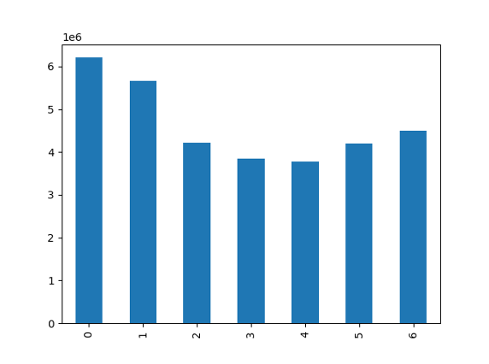
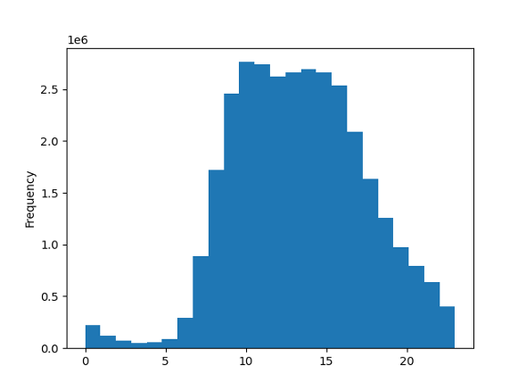
Instacart
Frequency by Day of Week and Hour of Day
Knowing which days have the most sales and also which hours of day are important to assist with knowing when to advertise or when to have promotions in order to create more sales. The days of the week are listed as 0-6 with 0 being Saturday and 6 being Friday. The hours is the standard 24-hour clock.

Slide 23
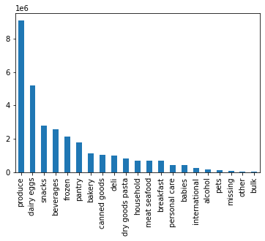
Instacart
Frequency by Department
We also wanted to find out which departments were the best sellers. This information will be useful for the company. It will help them with knowing what they can stock, knowing it will sell, and what to add promotions to, to encourage sales.

Slide 24
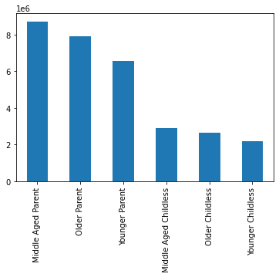
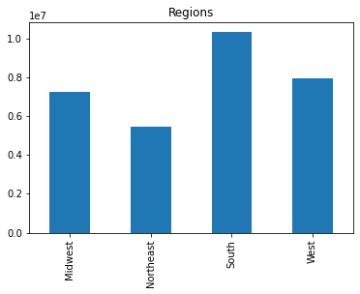
Instacart
Frequency by Marital Status & Age and Region
We also wanted to look at who were the main customers and where they were located. We separated the country into regions, as per Wikipedia, and separated the customer base into parents or childless and then also by age. This will help know who to target for certain products and where.

Slide 25
Instacart
Final Results
Certain days and times have more sales than others
Sales from different departments vary
Southern middle-aged parents are the biggest customer
Mon-Wed have the lowest amount of orders and should be prioritized for advertising
Ads should also be considered for the morning hours to encourage sales during the slow times.
Produce is the department with the most sales.
Look into providing discounts to departments with less sales, especially the easy to stock departments.
Talk to marketing about a new customer program for the Northeast and to childless people to improve customer base.
Target child products only to those with children.
GitHub

Slide 26
Global bank
05

Slide 27
Global bank
Objective
Tools Used
Skills Used
To identify any indicators that would explain why customers are leaving the bank.
Microsoft Excel
Microsoft Powerpoint
GitHub
Big data
Data Ethics
Data Mining
Predictive analysis
Time series analysis and forecasting

Slide 28
GLOBAL BANK
Decision Tree
More Likely
Client
40 and Older
Female
Male
Under 40
Male
Female
Active
Not Active
Not Active
Active
Active
Not Active
Not Active
Active
This decision tree is displaying the likelihood that a client will leave Pig E. Bank.
Less Likely

Slide 29
Global bank
Final Results
Over and under 40
Male or Female
Active or Not Active
Through our analysis we found that clients 40 and older were much more likely to leave Pig E. Bank.
Culients 40 and older are 36.3% likely to leave versus 9.9% for under 40.
Females are also leaving the bank at a much higher rate, 26.2% than males, 15.7%.
Clients who are inactive are 29.3% likely to leave whereas active clients are only 12.2% likely to leave.

Slide 30
World Happiness Report
06

Slide 31
World happiness report
Objective
Tools Used
Skills Used
Through exploratory analysis determine which countries are the happiest and what factors contribute to their happiness.
Microsoft Excel
Python
Tableau
Microsoft Powerpoint
Github
Sourcing open data
Visualizations with python
Regression model
Clustering
Time series analysis
Creating data dashboard

Slide 32
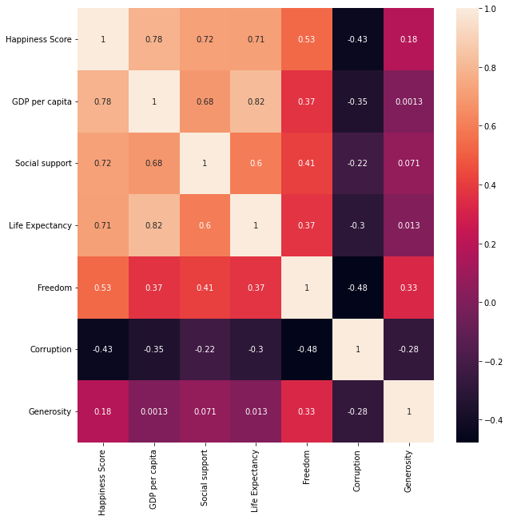
WHR
Correlation
One of the first things we did was look at the correlations between our factors and happiness score. From here we were able to determine that GDP per capita, Social support and Life expectancy all had a relatively high positive correlation and needed to be explored further.

Slide 33
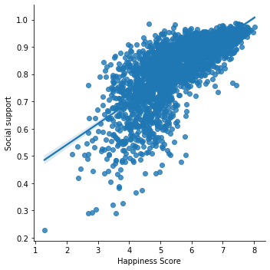
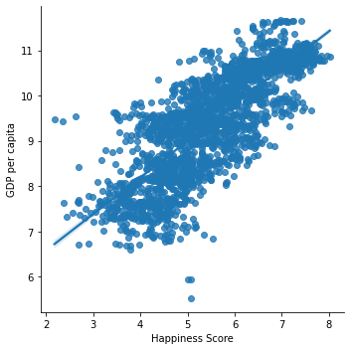
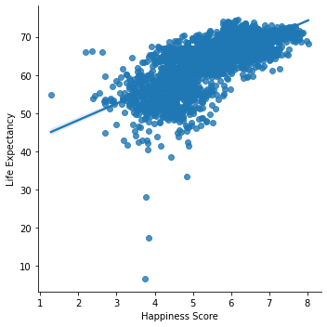
WHR
GDP, Social Support, Life Expectancy
Looking at the correlation graphs it is very clear that each one has a positive correlation with Happiness score. GDP per capita has a higher slope than the other two and therefore determined that our hypothesis would be "If a country has a high GDP per capital, then it will have a high happiness score”.

Slide 34
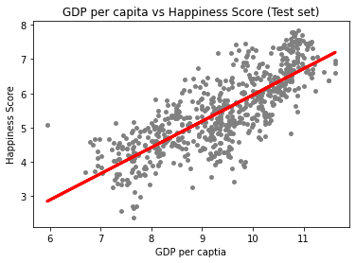
WHR
Regression Analysis
Next it was important to do a regression analysis to determine if correlation = causation. We determined it had a mean squared error of .40, meaning that the model should be fairly accurate. It also has an r-squared value of 0.612, meaning that 61.2% of changeability in the Happiness Score can can be explained by the model.

Slide 35
World Happiness Report
Final Results
The same countries tend to be the happiest year after year
GDP, Social Support and Life Expectancy
Other factors
Finland and Denmark seem to always be in the top happiest countries.
Countries in Northern Europe are some of the happiest.
GDP per capita has the highest relationship to happiness.
Social support and life expectancy also have a high relationship with happiness.
The other factors, mainly generosity and corruption have little impact on happiness score.
Generosity has a small but negative correlation with happiness score.
Tableau
GitHub

Slide 36
THANK YOU
Heather Visentin
Data Analyst

